Slide 1
JavaScript OO!?
Alex Chen
2015/10

Slide 2
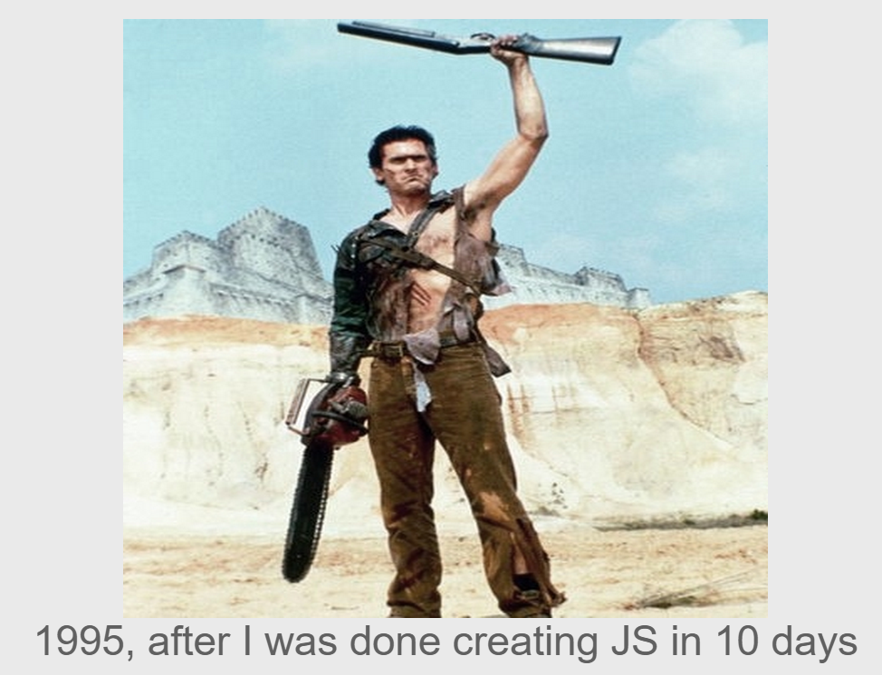
JavaScript background
https://brendaneich.github.io/ModernWeb.tw-2015/#5

Slide 3
Principles of OOPs
Encapsulation
Inheritance
Polymorphism

Slide 4
Encapsulation
Variable Scope
Closure
Access modifiers
Name Space

Slide 5
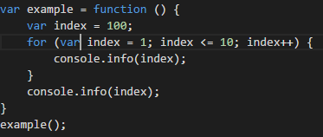
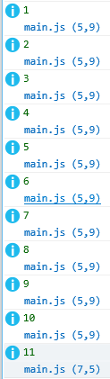
Variable Scope

Slide 6
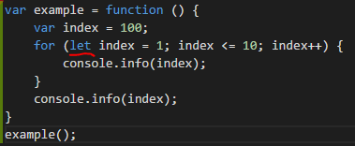
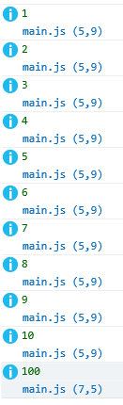
Variable Scope

Slide 7
Encapsulation
Variable Scope
Closure
Access modifiers
Name Space

Slide 8
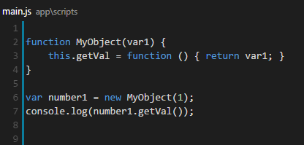
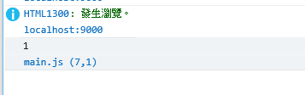
Closure
Notes:
當Function內與外界的變數接觸到之後，他會keep住這個變數的參考，封閉在function裡面，只能透過該function來存取，
並打包再一起，稱之為閉包。

Slide 9
Encapsulation
Variable Scope
Closure
Access modifiers
Name Space

Slide 10
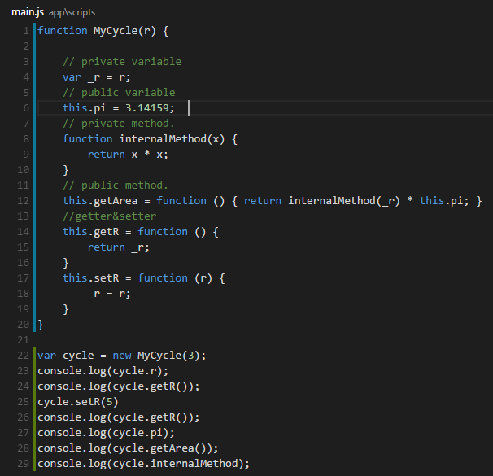
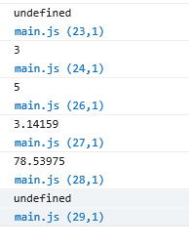
Access modifiers

Slide 11
Encapsulation
Variable Scope
Closure
Access modifiers
Name Space

Slide 12
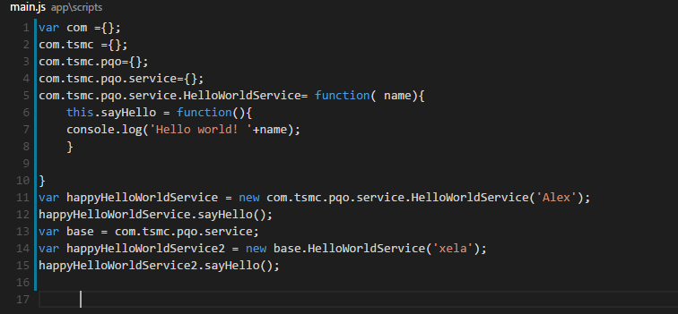

Name Space

Slide 13
Inheritance
World view of JavaScript
Inheritance design philosophy
Prototype-based
Function re-use

Slide 14
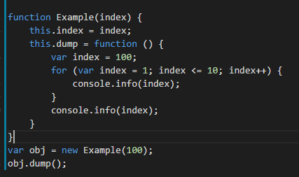
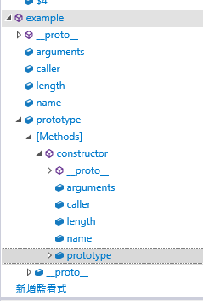
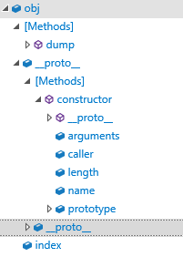
World view of JavaScript
Notes:
基本上就是兩種東西組成

Slide 15

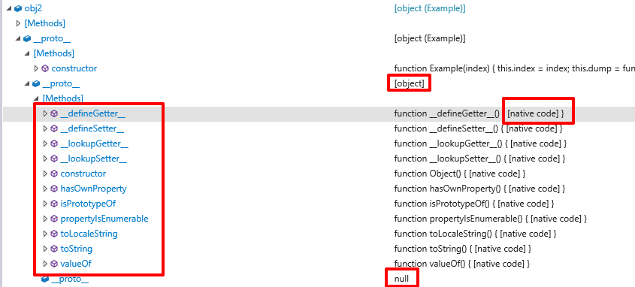
JavaScript world
Almost thing in the JavaScript world is object
The icon means this is an object.

Slide 16

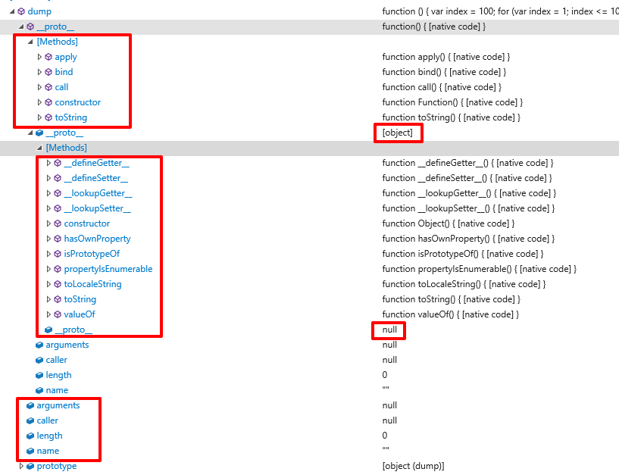
The icon means this is an function. Function is a special object in JavaScript world.

Slide 17
Inheritance
World view of JavaScript
Inheritance design philosophy
Prototype-based
Function re-use

Slide 18
Inheritance design philosophy
Java
Strong Type
Class-based
JavaScript
Week Type
Prototype-based
The major JavaScript philosophy is “Feature Compose”
class-less type test: Duck-test (James Whitcomb Riley)
“When I see a bird that walks like a duck and swims like a duck and quacks like a duck, I call that bird a duck.”

Slide 19
Inheritance
World view of JavaScript
Inheritance design philosophy
Prototype-based
Function re-use

Slide 20
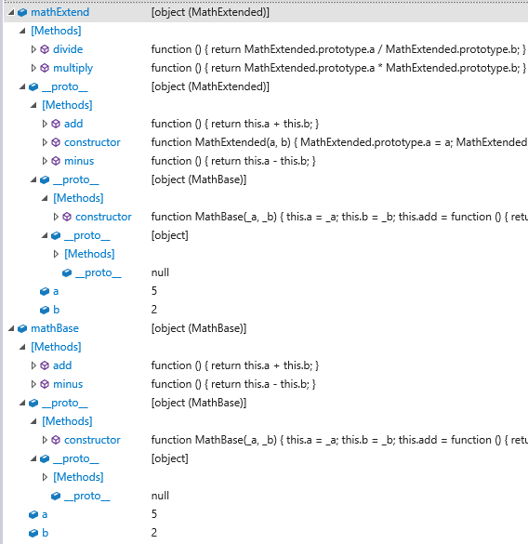
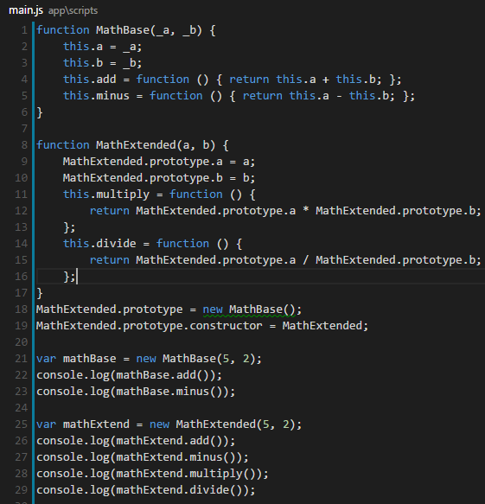
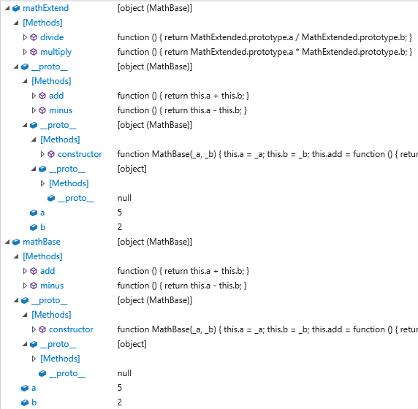
Prototype-based

Slide 21
Inheritance
World view of JavaScript
Inheritance design philosophy
Prototype-based
Function re-use

Slide 22
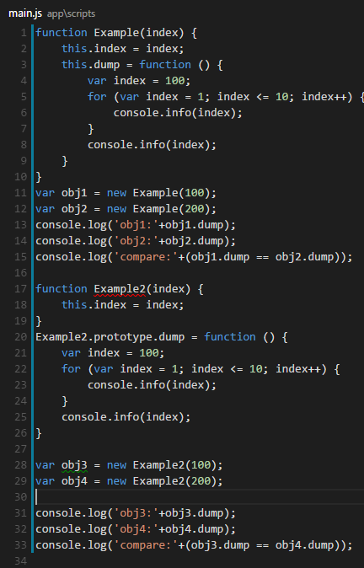
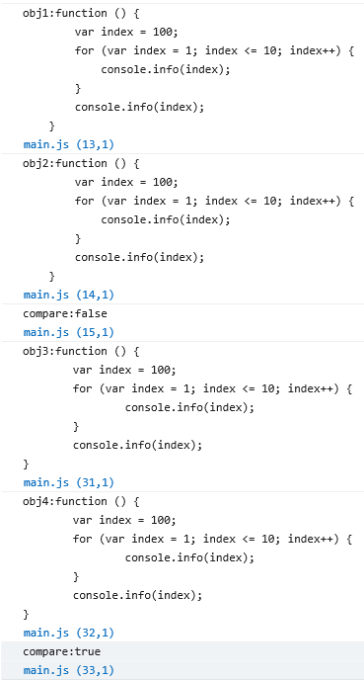
Function re-use

Slide 23
Polymorphism
Interface
Overriding

Slide 24
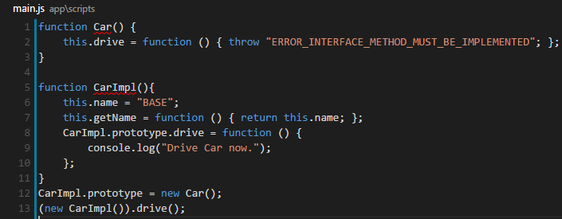

Interface
Notes:
要自己檢查
1. 主程式必須要確認物件有實作 Car 介面。 2. 主程式必須檢查物件確實實作了 Car介面中的方法。

Slide 25
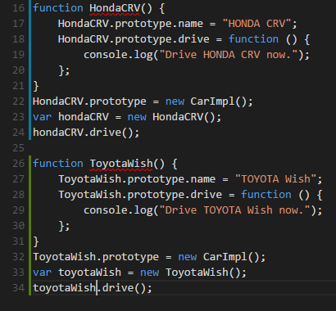

Overriding

